Slide 1
Implementing Multimodal Performance Planning in the Killeen-Temple MPO
Kendra Coufal
Killeen-Temple MPO
Uryan Nelson
Killeen-Temple MPO
Sydnee Steelman
Killeen-Temple MPO
Charlie Sullivan
CDM Smith
June 5, 2019

Slide 2
Killeen-Temple MPO Context
Sample Answers from Surveys
“Roads are ment for motorized vech vehicles not bikes. I don't allow my childern to play in the street, bicycles should know better.”
“…bike lanes are not necessary if lanes are wide and we all share.”
“Bike rack on front of bus=5”
Notes:
Killeen-Temple is unique in central Texas, spanning I-35, covering several communities and the Fort Hood Army base. But it is typical of American communities in that its auto mode share for the Journey to Work is about 93% . The bicycle mode share is reported as exactly 0%, and the shares for all other modes combined is less than the share for work at home.
The traditional auto-oriented planning process is therefore completely appropriate to serve and maintain the existing conditions. This is generally reflected in three sample results from surveys. The first shows a remarkable lack of logic, history, law, spelling, and grammar. The second has a better attitude towards active transportation, but is at best neutral and is ignorant of facts in the operations of bike lanes. The third recognizes the wonderful synergy gained from linking the bike mode with transit by citing bike racks as the top priority, but has failed to recognize that every single bus in the system already has bike racks attached.
Considering these things, we are lead to define four guiding principles for implementing multimodal performance planning:

Slide 3
Guiding Principles
Implementing multimodal planning requires changes in four topic areas:
Orientation
Data
Project Selection Criteria &
Performance Measures
Plans
You can’t determine the need for a bridge by counting how many people swim across the river
Notes:
Each of the principles involves attitude as well as data. Implementing each has to recognize that, with a 93% mode share for autos, the most immediately applicable direction to program projects is on traditional projects. But we must realize the limitations of that approach in the short term and the long term, and plan to build towards the desired integrated transportation system.

Slide 4
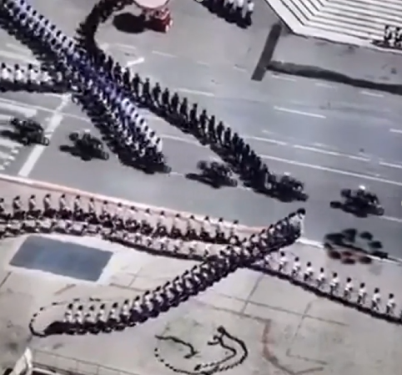
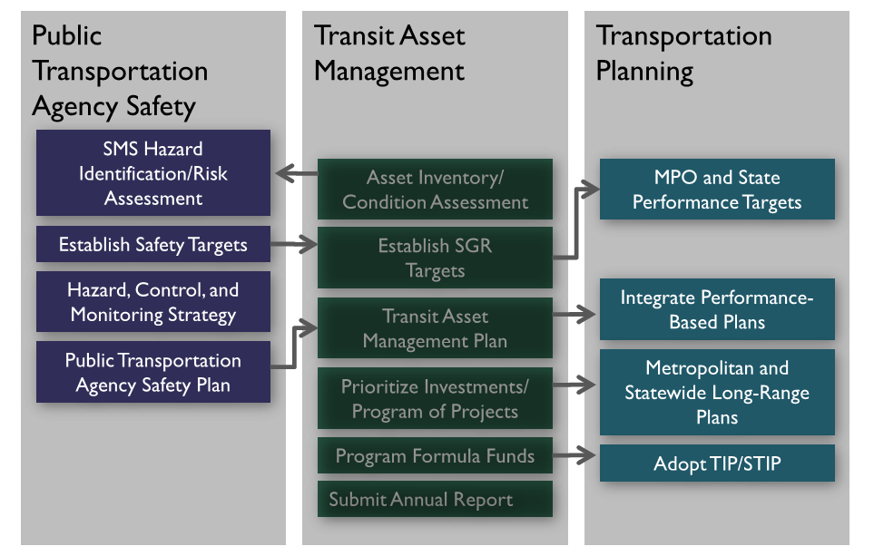
Orientation
Multimodal plans require less static and more dynamic relationships with complex orientations, data, and criteria needs
Notes:
FHWA had developed a very correct and useful chart that shows the linkages between existing plans that must be developed to implement multimodal planning. The reality is more like the chart on the left; more dynamic, with multiple lines of different kinds, moving in different directions at different speeds, constantly changing, and with each made up of individual elements which sometimes have a mind of their own. This graphic is really the core finding of our work; realizing the dynamic nature of the process and the constantly changing relationships and interconnectedness of all the elements.

Slide 5
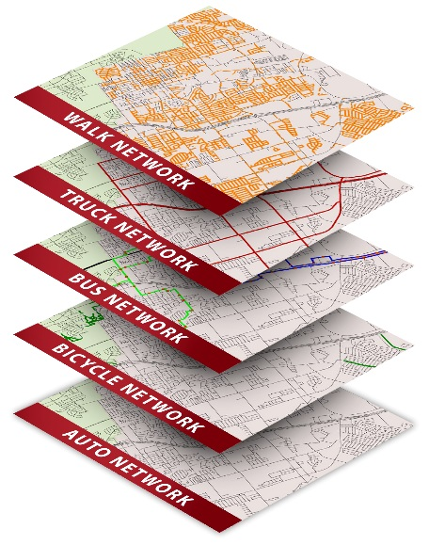
Data
Auto Mode: 8 Functional Classes and 5 Facility Types
Based on the balance between mobility and access
Bicycle Mode: 6 Functional Classes and 13 Facility Types
Based on safety
Bus Mode: 4 Functional Classes and 4 Facility Types
Based on amenities at stops
Truck Mode: 4 Functional Classes
Based on the desirability of trucks on the route
Walk Mode: 4 Functional Classes and 10 Facility Types
Based on safety
Notes:
The data are a key guiding principle. For the update of the Thoroughfare Plan into a Regional Multimodal Plan, for example, we defined functional classes and facility types for each of the five transportation modes covered. This totaled 36 different types of facilities, with each based on different purposes. Expanding the functional class and facility types drove the need to expand the inventory data for each mode, and the data necessary for each modes’ performance measures. In the end, we found that we could only make a first pass at the data collection, and finished by defining some good theoretical performance measures that we had to defer implementing until we could collect the base data.

Slide 6
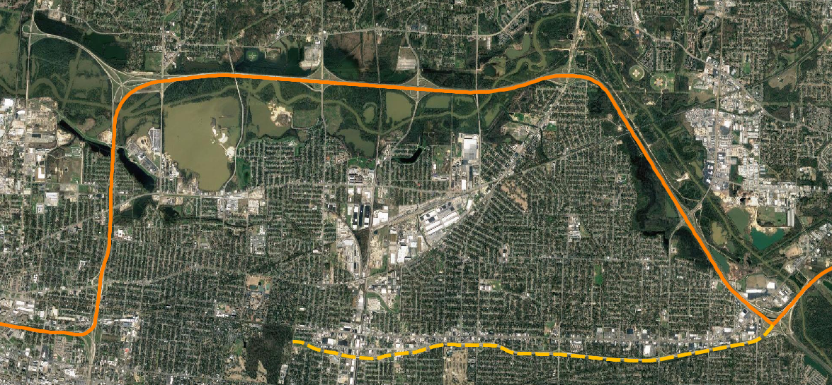
Project Selection Criteria & Performance Measures
Routing of I-40 in Memphis and Overton Park Citizens to Preserve Overton Park vs Volpe 401 US 402 1971
They weren’t wrong; but their evaluation criteria were incomplete
Notes:
The importance of selection criteria are best illustrated by an old example of building I-40 through Memphis. The criteria were to build as straight and as cheaply as possible, with as little use of eminent domain and taking of houses as possible. With these criteria, building the interstate through a park made perfect sense, even though the Section 4(f) requirements were already in place. The local people supporting the park took their case to the Supreme Court and ultimately won, forcing the route to detour all the way around the city. The route selected still had to use some eminent domain and destroy some houses….but they were in a low income neighborhood rather than high-income.
The engineers were not wrong; they were limited by following criteria that were incomplete. As in this example, either following or trying to correct incomplete criteria can lead to undesirable effects.

Slide 7
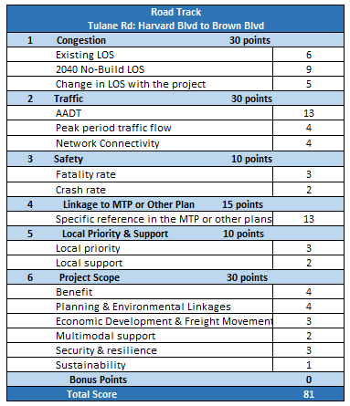
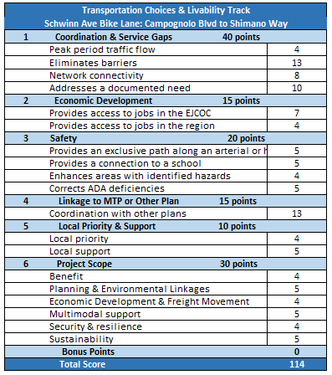
Project Selection Criteria
Notes:
KTMPO has adopted a two-tracked evaluation criteria; one track for roads and one for transportation choices and livability. Each has multiple criteria with objective and subjective measures; and each score is weighted to reflect the local priorities. There is a final provision for a limited number of bonus points to reflect additional support for a project, but they must be documented.

Slide 8
Plans
Thoroughfare Plan
Project Selection Process
Public Participation Plan
Evaluation of ranked projects
Performance Measures
Future Growth Scenarios
Freight Parking Study
Transit Demand Study
Corridor Studies
Environmental Justice Study
Bike Share Study
Vulnerability & Resilience Study
Notes:
The final guiding principle is the multiplicity of plans; both updates of existing plans and the development of completely new plans to broaden the scope and coverage of the planning process. As the planning process expands, the linkages are being built, and as transportation choices expand, the planning process must expand with it.

Slide 9
Thank You!
Kendra Coufal
Killeen-Temple MPO
Kendra.Coufal@CTCOG.org
Charlie Sullivan
CDM Smith
SullivanC@CDMSmith.com
If people aren’t walking or biking or taking transit, that’s not a sign that they don’t want to.
It’s a sign that they don’t have a real choice.

